Slide 1



Slide 2
Relaxation Oscillator
The second major category of oscillators is the relaxation oscillator. Relaxation oscillators use an RC timing circuit and a device that changes states to generate a periodic waveform.
its differ from feedback osc. In the case of it is not contain any feedback.

Slide 3
Triangular-Wave Oscillator
It is the same as op-amp integrator circuit.
It is produce a triangular wave at the output.

Slide 4
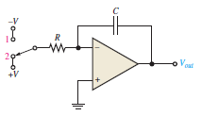

Triangular-Wave Oscillator

Slide 5
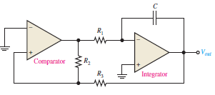
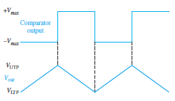
Practical Triangular-Wave Oscillator

Slide 6
Practical Triangular-Wave Oscillator
To begin, assume that the output voltage of the comparator is at its maximum negative level. This output is connected to the inverting input of the integrator through producing a positive-going ramp on the output of the integrator.
When the ramp voltage reaches the upper trigger point (UTP), the comparator switches to its maximum positive level. This positive level causes the integrator ramp to change to a negative-going direction.
The ramp continues in this direction until the lower trigger point (LTP) of the comparator is reached. At this point, the comparator output switches back to the maximum negative level and the cycle repeats.

Slide 7


Practical Triangular-Wave Oscillator
Since the comparator produces a square-wave output, this circuit can be used as both a triangular-wave oscillator and a square-wave oscillator.
Devices of this type are commonly known as function generators because they produce more than one output function.
The output amplitude of the square wave is set by the output swing of the comparator, and the resistors R2 and R3 set the amplitude of the triangular output by establishing the UTP and LTP voltages according to the following formulas:

Slide 8
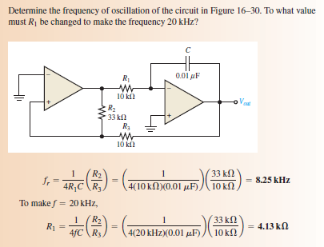
Practical Triangular-Wave Oscillator

Slide 9
Sawtooth Voltage-Controlled Oscillator (VCO)
The voltage-controlled oscillator (VCO) is a relaxation oscillator whose frequency can be changed by a variable dc control voltage.
One way to build a sawtooth VCO is with an op-amp integrator that uses a switching device (PUT) in parallel with the feedback capacitor to terminate each ramp at a prescribed level and effectively “reset” the circuit.
PUT is a programmable unijunction transistor with an anode, a cathode, and a gate terminal.

Slide 10
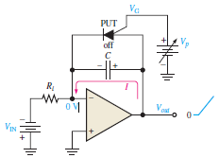
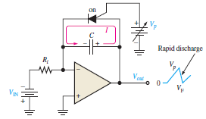
VCO

Slide 11
VCO
The operation of the sawtooth VCO begins when the negative dc input voltage, produces a positive-going ramp on the output. During the time that the ramp is increasing, the circuit acts as a regular integrator.
The PUT triggers on when the output ramp (at the anode) exceeds the gate voltage by 0.7 V. The gate is set to the approximate desired sawtooth peak voltage.
When the PUT turns on, the capacitor rapidly discharges.
The capacitor does not discharge completely to zero because of the PUT’s forward voltage Vf.
At this point, the PUT turns off and the capacitor begins to charge again, thus generating a new output ramp.
The sawtooth amplitude and period can be adjusted by varying the PUT gate voltage.

Slide 12


VCO
The frequency of oscillation is determined by the Ri and C of the integrator and the peak voltage set by the PUT.
The charging rate of a capacitor is VIN/RiC .
The time it takes a capacitor to charge from VF to Vp is the period, T, of the sawtooth waveform.

Slide 13
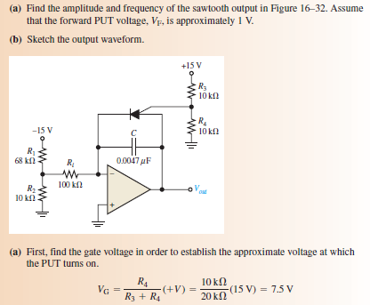
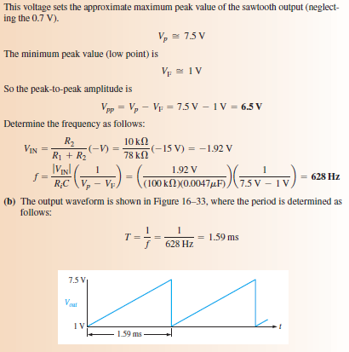
VCO

Slide 14
Square Wave Oscillator
The basic square-wave oscillator is a type of relaxation oscillator because its operation is based on the charging and discharging of a capacitor.
When the circuit is first turned on, the capacitor is uncharged, and thus the inverting input is at 0 V. This makes the output a positive maximum, and the capacitor begins to charge toward Vout through R1.
When the capacitor voltage Vc reaches a value equal to the feedback voltage Vf on the noninverting input, the op-amp switches to the maximum negative state. At this point, the capacitor begins to discharge.
When the capacitor voltage reaches -Vf the op-amp switches back to the maximum positive state and the action continues to repeat.

Slide 15
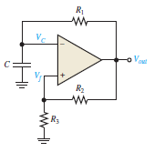
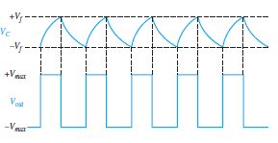
Square Wave Oscillator

